Slide 1
كشف الأحداث ومراقبتها في وسائل التواصل الاجتماعي اعتمادً على تقنيات التعلم العميق
تقديم: حسن خضور
إشراف: د. رياض سنبل
3/6/2023

Slide 2
Table of Content
Introduction
Work Plan & Completed Stages
System Architecture
Next Step
Event Detection and Monitoring in Social Media

Slide 3
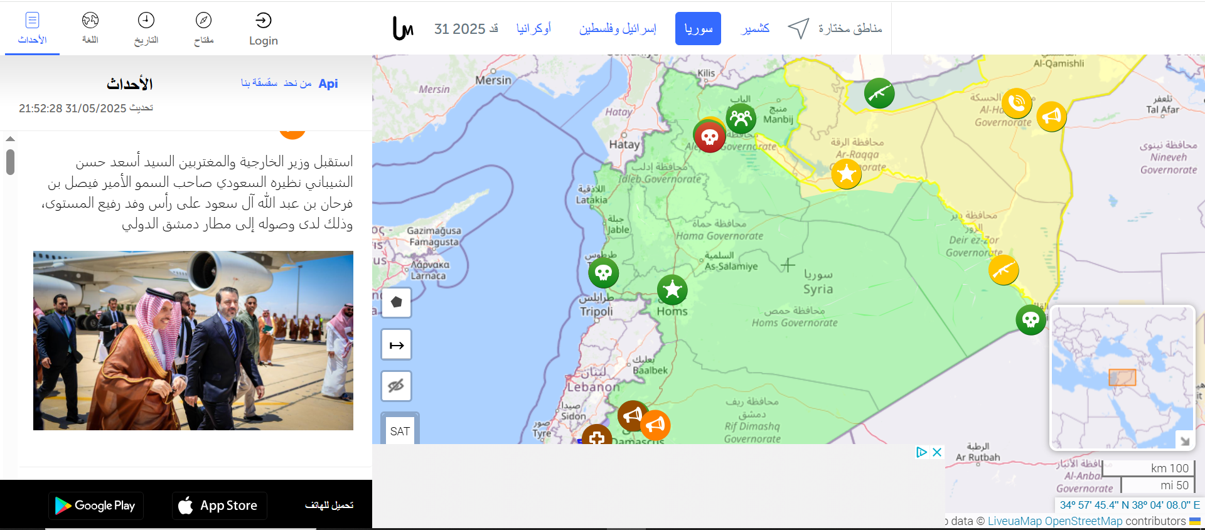
Introduction
[Syria.liveuamap.com]
Event Detection and Monitoring in Social Media

Slide 4
Introduction
What is our Project?
Detect events from Arabic social media posts.
Inspired by Liveuamap, but focused on automated, AI-driven event detection. Displays daily incidents on a map for public and decision-maker awareness.
Why Do We Need This?
Social media is often the first source of real-time event reporting.
No similar system focused on Arabic social media exists.
Event Detection and Monitoring in Social Media

Slide 5
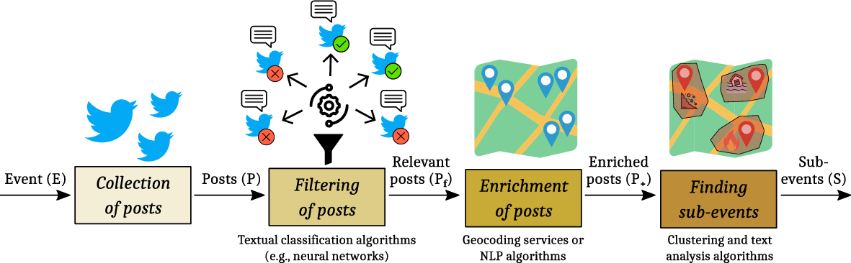
Problem Statement (Academic Perspective)
Location inference
Detect events from data stream
Dealing with large amount of data
an example of how is the general works (Belcastro et al ).
Event Detection and Monitoring in Social Media

Slide 6
Work Plan
Previous Sprints
Implementing first release of the platform
Micro-services solution
Collect real data from twitter
Base lines for the filter model, Detection Model
Explore the related work approaches
Event Detection and Monitoring in Social Media

Slide 7
Work Plan
Platform First Release
Scraping Management service
Scraping Agent (from telegram)
Location Inferences with LLM
Detection Service (naive)
Events Service
Frontend
Event Detection and Monitoring in Social Media

Slide 8
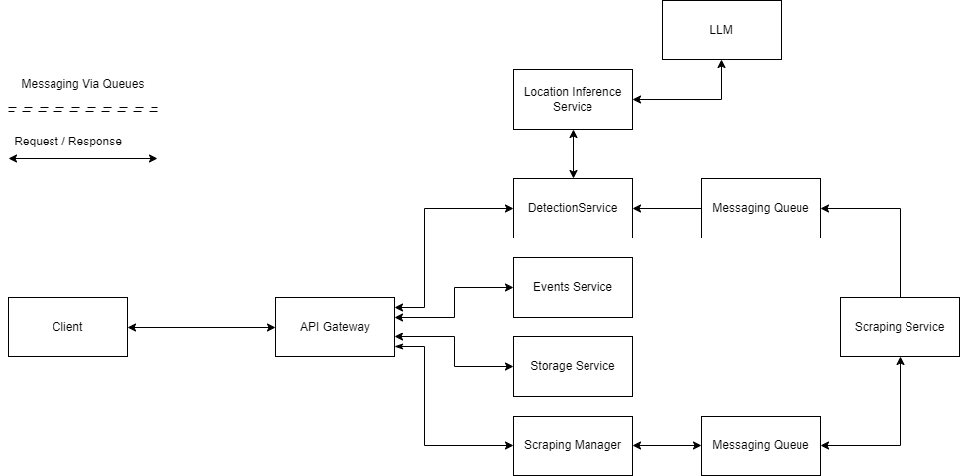
Work Plan
Event Detection and Monitoring in Social Media

Slide 9
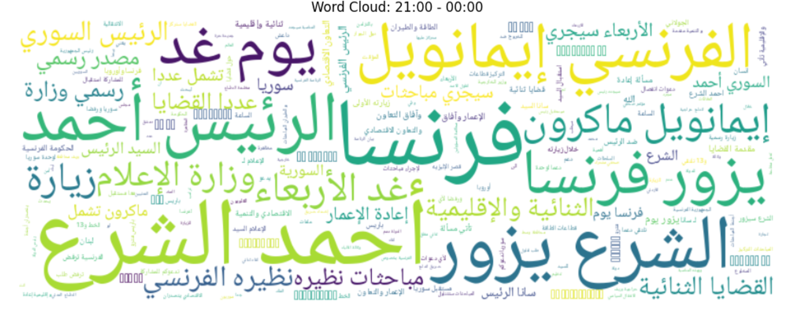
Work Plan
Collect Real Data from Twitter
~17.000 Tweet
Manual Labeling for 4.000 Tweet
From 1 to 31 May 2025
Belong to 103 Event
Event Detection and Monitoring in Social Media

Slide 10
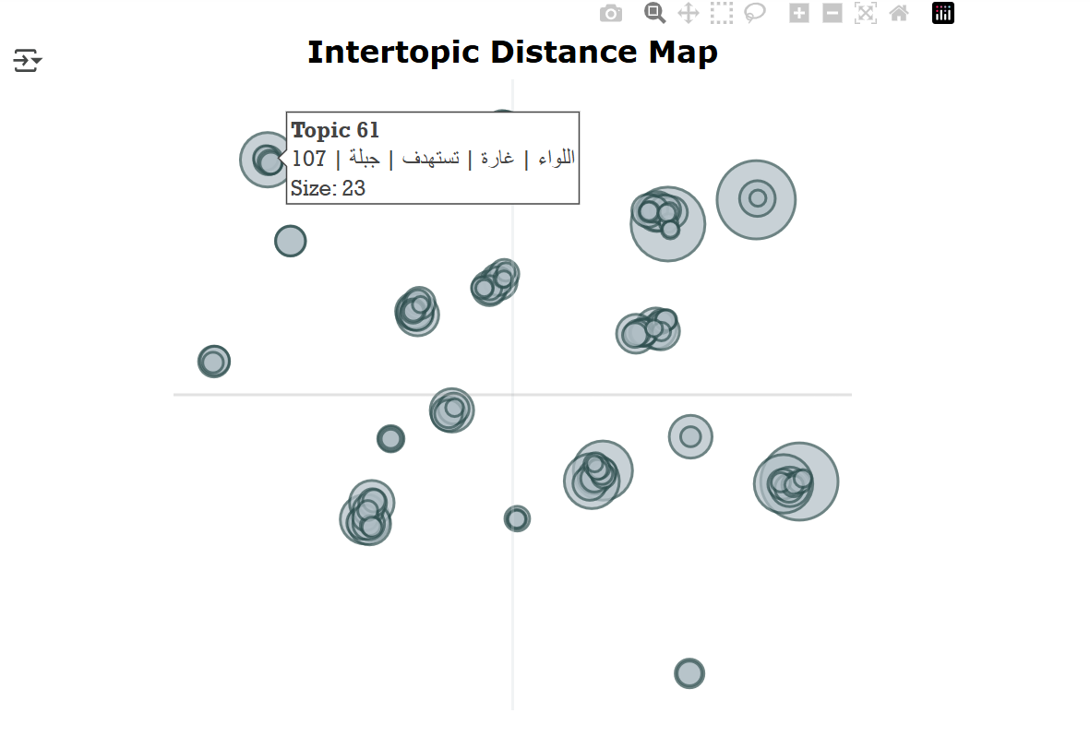
Work Plan
Base Line Models
For tweet filtering we get a 85% accuracy
For Clustering:
we explore topic modeling approaches
we explore BERTopic as baseline
Event Detection and Monitoring in Social Media

Slide 11
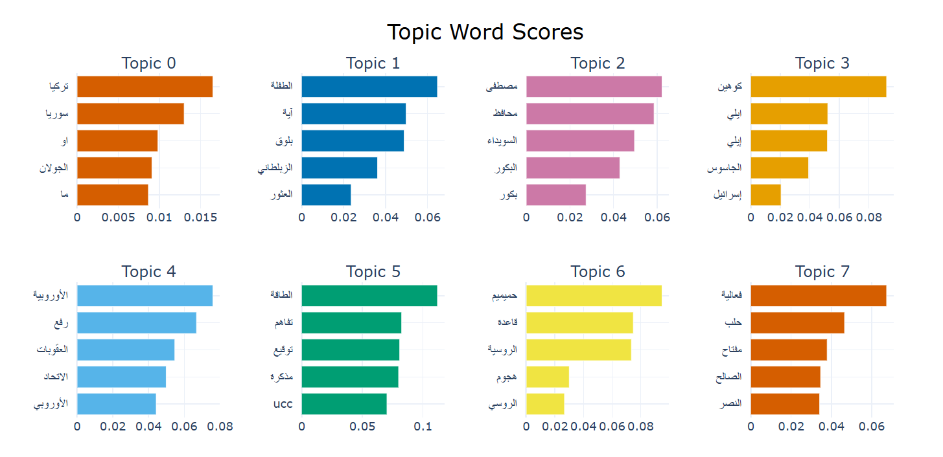
Work Plan
Base Line Models
Event Detection and Monitoring in Social Media

Slide 12
Next Step
What we will do in the next sprints:
Refine the overall system
Enhance the filtering model
Focus on and Enhance the Detection Approach
Define and Evaluate the Location Inference Approach
Event Detection and Monitoring in Social Media

Slide 13
Thanks!!
Event Detection and Monitoring in Social Media

Slide 14
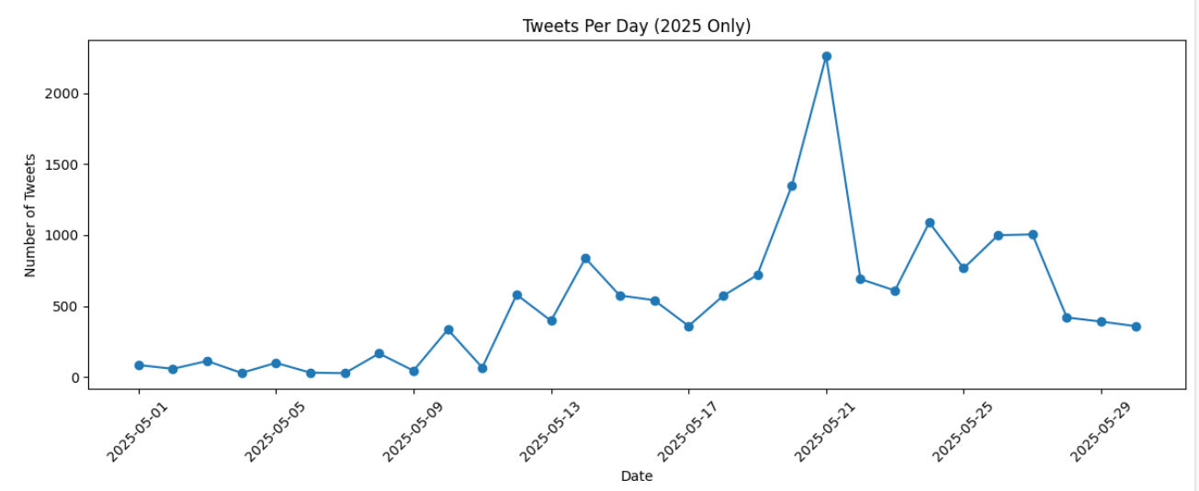
Introduction
Event Detection and Monitoring in Social Media

Slide 15
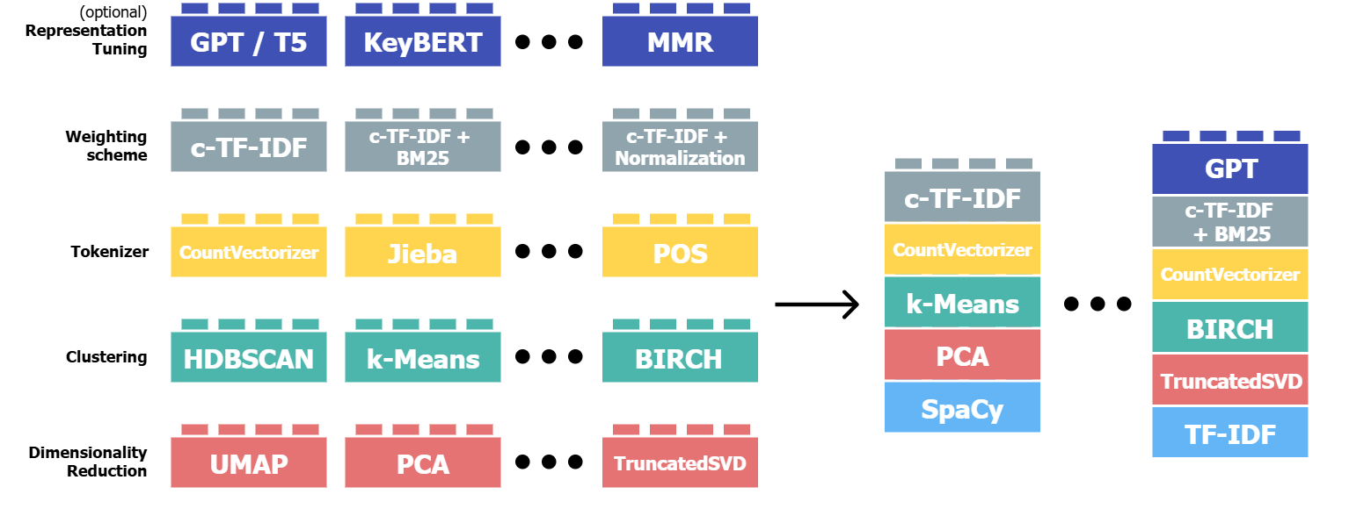
BERTopic
Event Detection and Monitoring in Social Media

Slide 16
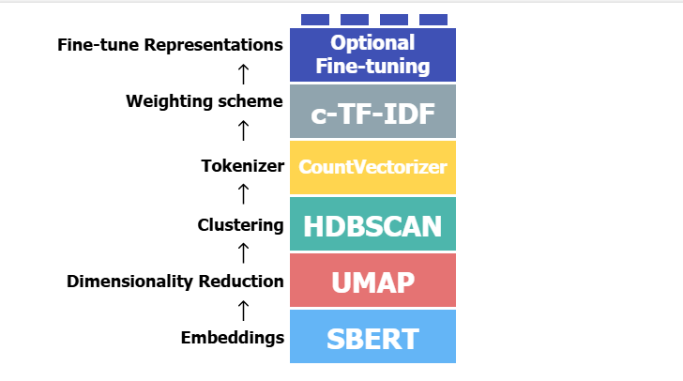
BERTopic
Event Detection and Monitoring in Social Media

Slide 17
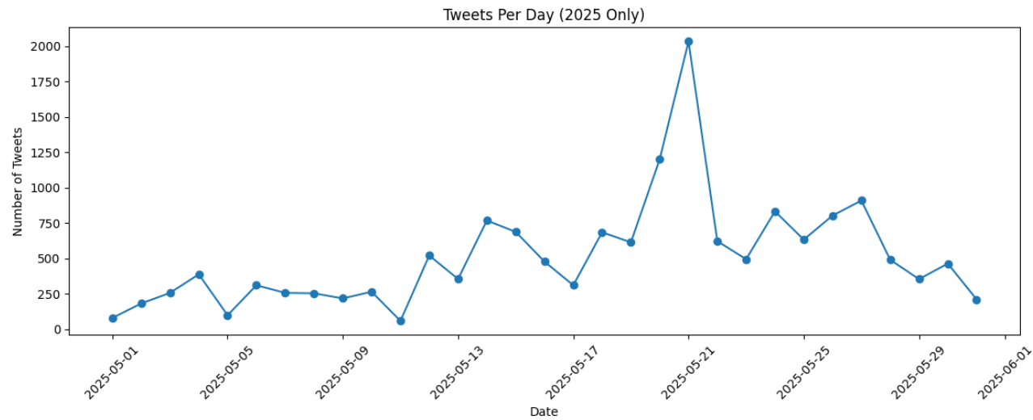
Work Plan
Collect Real Data from Twitter
~20.000 Tweet
Manual Labeling for 4.000 Tweet
From 1 to 31 May 2025
Belong to 103 Event
Event Detection and Monitoring in Social Media

Slide 18
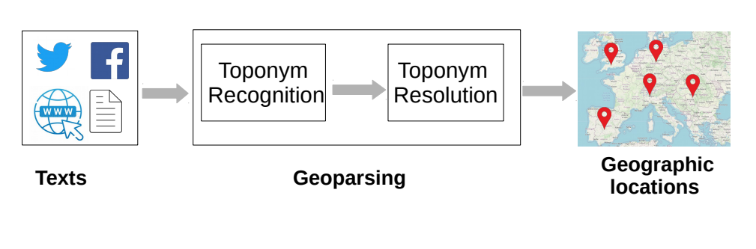
Introduction
Event Detection and Monitoring in Social Media

Slide 19
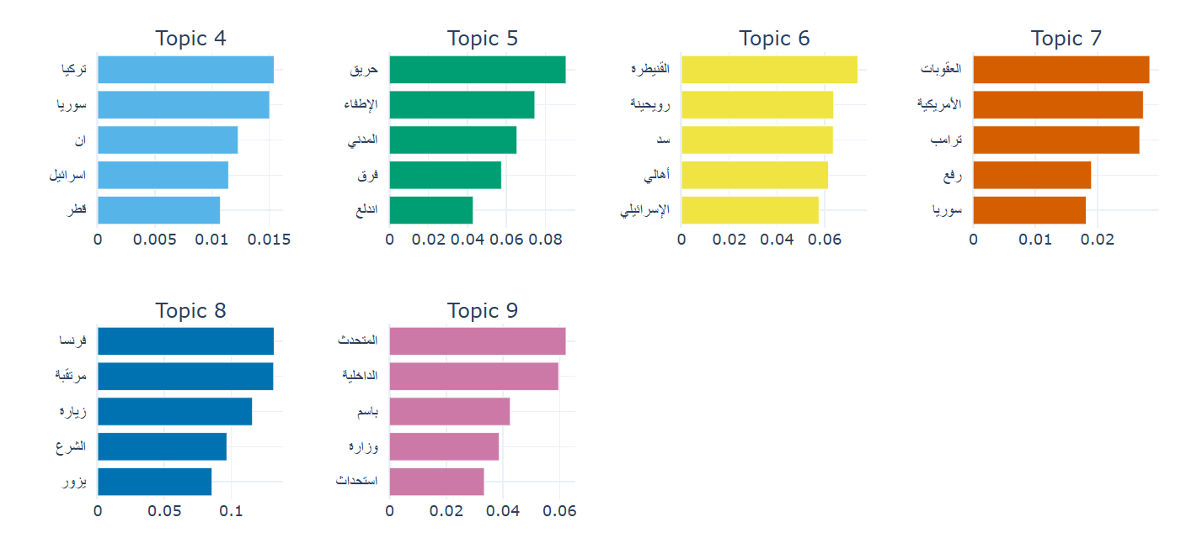
Work Plan
Base Line Models
~20.000 Tweet
Manual Labeling for 4.000 Tweet
From 1 to 31 May 2025
Belong to 103 Event
Event Detection and Monitoring in Social Media

Slide 20
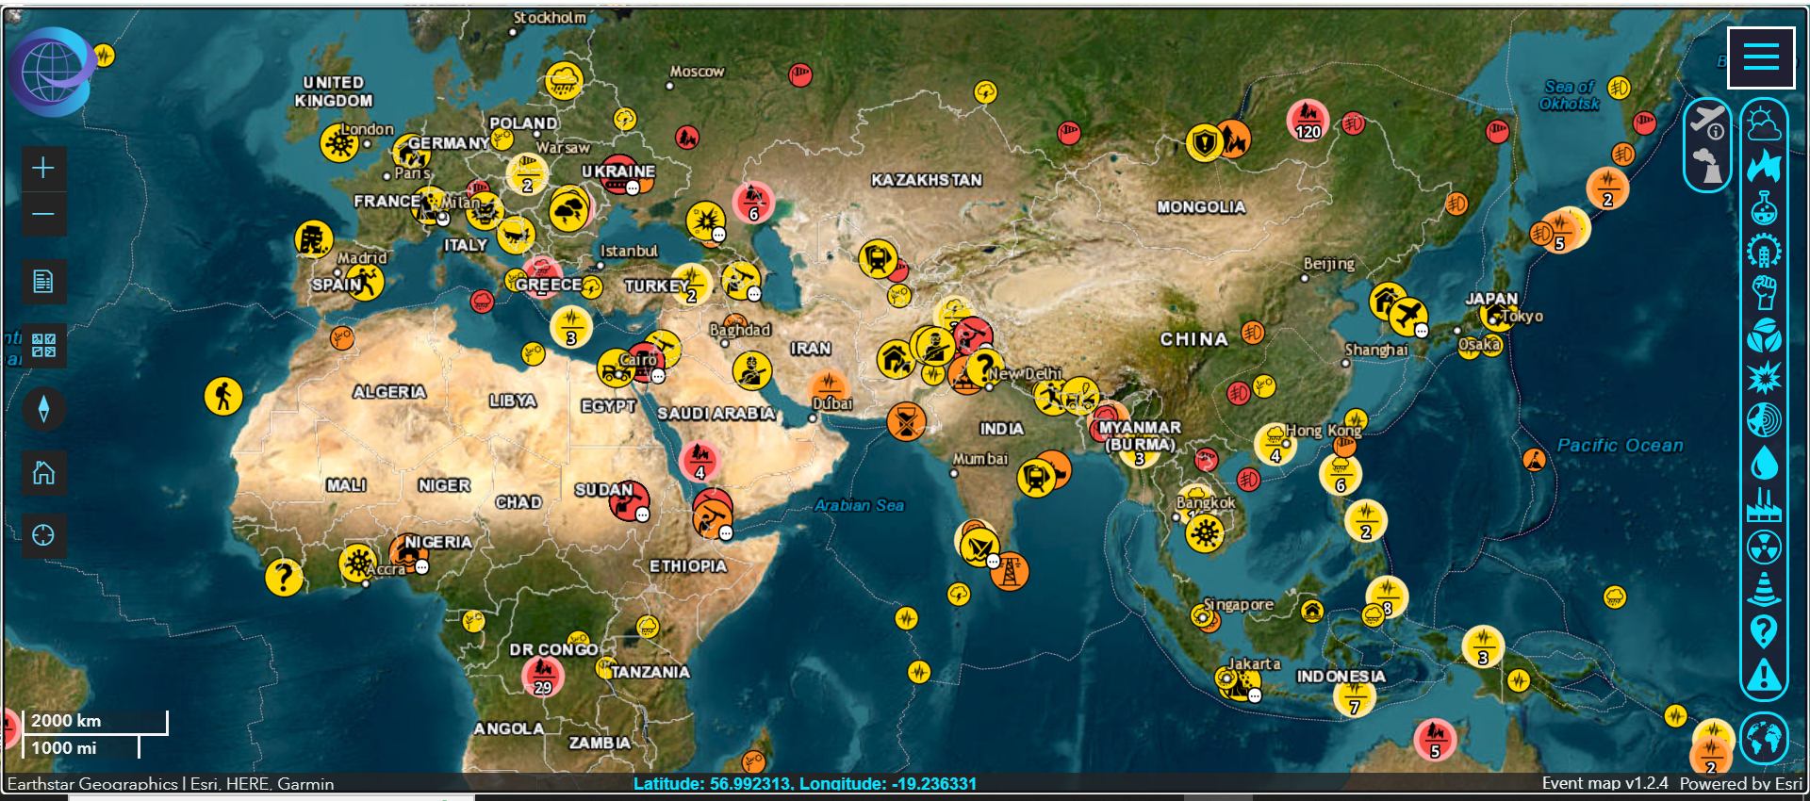
Introduction
[rsoe-edis.org]
Event Detection and Monitoring in Social Media

Slide 21
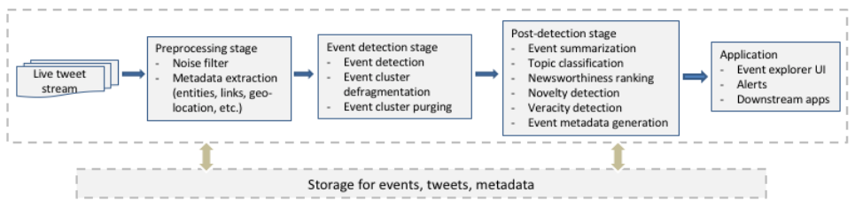
Introduction
The typical workflow for a NED system for unspecified events (Q. Li et al., 2022).
Event Detection and Monitoring in Social Media

